Slide 1
Life’s a Happy Song
Singing for Health and Well-Being
Presented by Kimberley Denis

Slide 2
About 85% of us have been told we can’t sing.

Slide 3
Benefits of Singing
Physical
Mental
Social

Slide 4
Physical Benefits of Singing

Slide 5
Tension Release
Improved Posture
Improved Heart & Lung Health
Look Younger

Slide 6
“Music is like a huge release of tension.” - James Taylor
Exercises for Releasing Tension

Slide 7
“I want to get old gracefully. I want to have good posture, I want to be healthy and be an example to my children.” - Sting
Exercises for Improving Posture

Slide 8
“Singing is like a celebration of oxygen.” – Bjork
Breathing Exercises

Slide 9
Happiness is that face you make when singing your favourite part of a song
Facial Muscle Awareness Exercises/Developing Expressivity

Slide 10
Mental Benefits of Singing

Slide 11
“He who sings scares away his woes.”
– Miguel de Cervantes Saavedra
(Spanish novelist)

Slide 12
Increase in self esteem and confidence – self fulfilling prophesy
It increases feelings of well-being and reduces anxiety
It enhances mood
Useful as a stress reducer

Slide 13
It can increase positive feelings
Encourages creativity
It can be energizing
It evokes emotions
Gives individuals a voice

Slide 14
Hey ho, nobody’s home
Meat nor drink nor money have I none
Yet will I be merry!

Slide 15
Social Benefits of Singing

Slide 16
Promotes bonding through release of hormone oxytocin
Increases understanding and empathy between cultures.
Widens circle of friends
Builds communication skills

Slide 17
Brings people together and encourages a sense of community
A forum for fun and laughter
Community of support
Safe environment to try new skills

Slide 22
Hey ho, nobody’s home
Meat nor drink nor money have I none
Yet will I be merry!

Slide 23
Hey ho, nobody’s home
Meat nor drink nor money
have I none
Yet will I be merry! (sing 3x)
Hey ho hey yo 3x

Slide 24
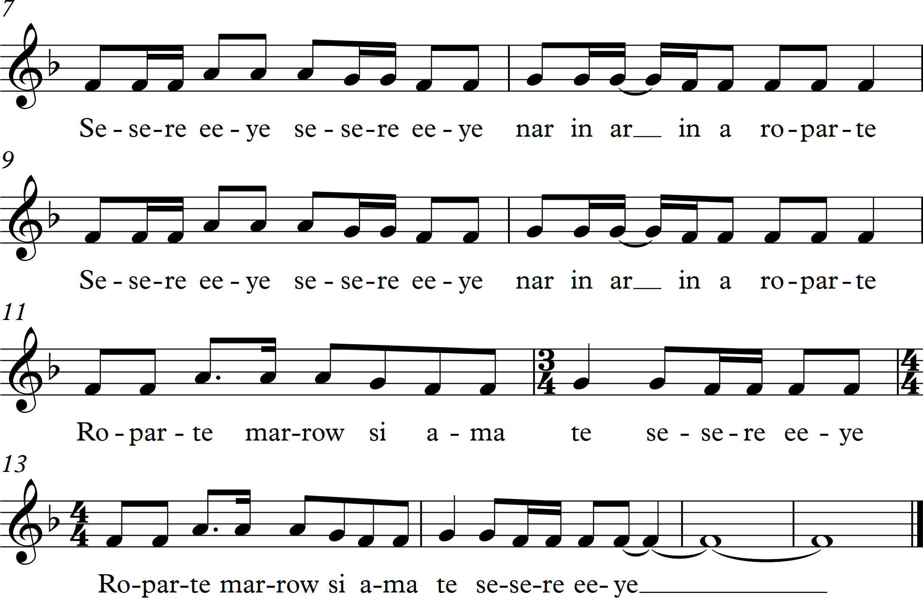

Slide 25
Berthold Auerbach (German poet) meant it when he said:
"Music washes from the soul, the dust of everyday life".

Slide 26
Group singing is cheaper than therapy, healthier than drinking, and certainly more fun than working out. It is the one thing in life where feeling better is pretty much guaranteed.

Slide 27
“Sing like no one is listening, love like you’ve never been hurt, dance like nobody’s watching and live like it’s heaven on earth.” – Mark Twain

Slide 28
Questions?
Kimberley Denis
www.kimdenis.com

