Slide 1
Explorations and Discoveries
The Child’s Voice

Slide 2
www.kimdenis.com kimdenis@hotmail.com

Slide 3
This session will focus on the development of the child’s singing voice and will include repertoire ideas to use in worship that encourage singing, some do’s and don’ts when hunting for repertoire, and some great exercises and games to use to encourage children to sing

Slide 4
The success of a children’s choir is due in large part to two things: 1. The Repertoire 2. The Conductor’s Ability to Teach It

Slide 5
Development of the Singing Voice
Head Voice, Head Voice, Head Voice!!!

Slide 6
So Low!
Many popular teaching books for music educators and worship leaders cater to the teacher and not the singer.
These songs are too low!
Healthy vocal development relies on the use and development of head voice.
Great and easy exercises (watch out for mouth shape):
Sirens
Laughing
Monkey Sounds
Boomerang – don’t forget to catch it!

Slide 7
Choosing Repertoire: Vocal Range
Can the singers stay primarily in mid-register and head voice?
Pre-School to Grade Two
Upper Elementary
Junior High – Mid-Register
Junior High – Full Range
Transposition is your friend!

Slide 8
Choosing Repertoire: Vocal Range
For changing voice boys, is the range limited?
For recently changed voice boys, does the baritone line go too high?
Use Drones!
Aeyaya Balana Sakkad – Indian Folk Song, arr. John Higgins
Changing Voices
Changed Voices

Slide 9
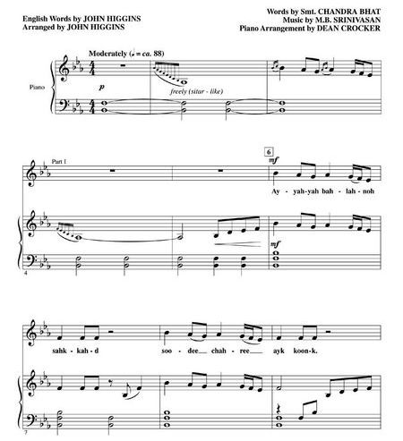
Aeyaya Balana Sakkad – Using Drones

Slide 10
Melodic Intervals
Is it an accessible and interesting melodic line?
Primarily steps or leaps?
How are awkward intervals approached?
Homeward Bound – Marta Keen, arr. Jay Althouse

Slide 11
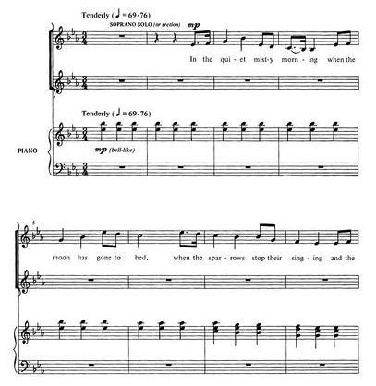
Homeward Bound – Steps and Leaps

Slide 12
Harmonic Intervals
Is the harmony accessible?
Two, three or four parts?
Can the baritone line be doubled by treble voices?
A Jubilant Song – Mary Lynn Lightfoot

Slide 13
A Jubilant Song – 2 part

Slide 14
Tempo
Is there a variety of tempi in your programming?
Children’s hearts beat faster than adults so our perception fast tempos may actually feel more like a medium tempo.
Slow and lyrical pieces shouldn’t be avoided – my rule of thumb is for every four pieces, I can use one slower, more lyrical piece.
Hine Ma Tov

Slide 15
Age-Appropriate Text
Nursery rhymes and folk songs are great for Pre-School through grade two
By grade three, singers are able to grasp much deeper texts and can thoughtfully reflect and analyze texts.
Discussions about text, meaning, and message are an important part of the rehearsal process.
Shalom, Pacem, Peace – Ruth Elaine Schramm

Slide 16
Shalom, Pacem, Peace – Ruth Elaine Schramm
Shalom aleichem, aleichem Shalom
Dona nobis pacem, pacem, pacem
Peace be unto you, and unto you, and unto you be peace

Slide 17
Gender-Appropriate Text
Girls don’t always like to sing about flowers. Find songs about strength, courage, and perseverance
Boys rarely like to sing about flowers. They also enjoy something other than sea shanties and military songs.
Boys love a deep text – they love to puzzle over meaning. Some of our best discussions about text were about Schuberts’ Wanderers Nachtlied

Slide 18
Wanderers Nachtlied
Der du von dem Himmel bist, Alles Leid und Schmerzen stillest, Den, der doppelt elend ist, Doppelt mit Erquickung füllest; Ach, ich bin des Treibens müde! Was soll all der Schmerz und Lust? Süßer Friede, Komm, ach komm in meine Brust!
Thou that from the heavens art, Every pain and sorrow stillest, And the doubly wretched heart Doubly with refreshment fillest, I am weary with contending! Why this rapture and unrest? Peace descending Come ah, come into my breast!

Slide 19
Language
Don’t be afraid of other languages. There are a host resources online to help you teach texts, provide translations, and offer interpretations.
Oye – Jim Papoulis

Slide 20
Shumayela
Esta solo, llorando
En silencio, en la oscuridad
Esta sonando, deseando
Con esperanza, por la opportunidad.
Escuchalos, escuchalos, ellos te llaman.
All alone, in the darkness
They are crying out for your help
They are hoping, they are dreaming
They are asking, for a change to be heard.
Are you listening, can you hear their cries?

Slide 21
Oye - Language

Slide 22
Oye – Young Adelaide Voices, Neerpelt, Belgium

Slide 23
Arrangement
If the arrangement doesn’t work for your current ensemble, it’s okay to change it if the essence of the piece fits your mandate.
Northern Lights – Frode Fjellheim
SSAA but the alto two part was very low
Super high descant part on soprano 1 didn’t add much to the piece
Transposed up one semitone and it worked

Slide 24
Diversity in Style
Young singers will sing in any style, you just need to show them how. Don’t hesitate to try world music, selections from the classical canon, a cappella works, or music accompanied by non-traditional instruments.
Better yet, have the singrs play instruments themselves!
Deo – Donna Rhodenizer

Slide 25
Deo – Using Instruments

Slide 26
Active Participation
If you have a chorister that loves to beat box, let them! They’ll be able to help you figure out where they think it fits in best.
Movement, as long as it enhances and doesn’t detract from vocal production, is a great way to get choristers to engage with their bodies and sing!

Slide 27
The Flops of the Fifties

Slide 28
Active Participation
Choristers and congregations alike take risks when they feel safe to do so.
Kumbaya, Lord, Kumbaya
Kumbaya, Lord, Kumbaya
Kumbaya, Lord, Kumbaya
Kumbaya, Lord, Kumbaya
Somebody’s singing, Lord, Kumbaya woh
Somebody’s singing, Lord, Kumbaya woh
Somebody’s singing, Lord, Kumbaya woh
Singing sun, rain, storm or fire , Kumbaya

